Slide 1

Optimizing Sales Strategy for New Product Launch
"Driving Business Growth Through Data Analytics”
Romuald Tcheutchoua
Professional Data Analyst
28-Jan-2024

Slide 2

Project Overview
Business objective: launching of a new sales product.
Problem: what is the most cost-effective selling strategy which adapts to technological change?
Project objective: Use the analysis of sales data to unveil the best cost-effective strategy and propose a metric which can help to monitor and drive business growth in the face of technological advancement.

Slide 3
Summary of data analysis process
Data cleaning
Data types: the column ‘week’ was converted to categorical
Data entry issues: all ‘sales_method’ values were aligned with [‘Email’, ’Email + Call’, ‘Call’]
Missing data: missing values in ‘revenue’ were filled with the mean of overall revenue
Outliers(extreme/weird values): two rows with ‘years_as_customer’ greater than 40 were removed

Slide 4
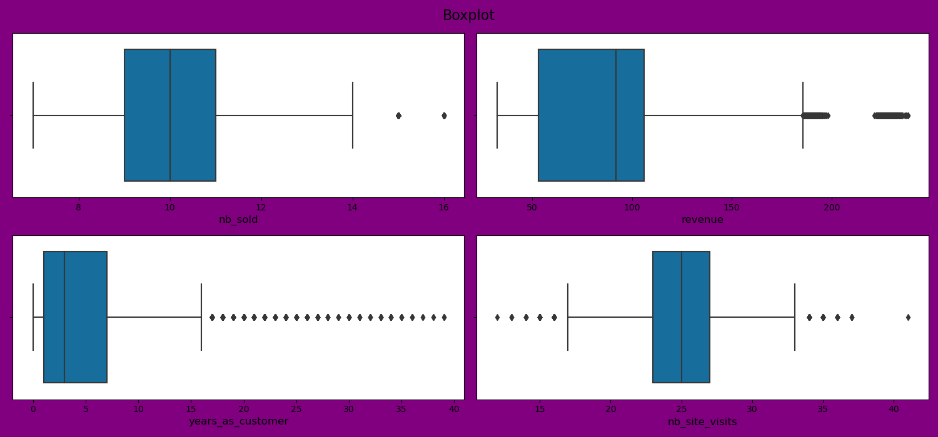
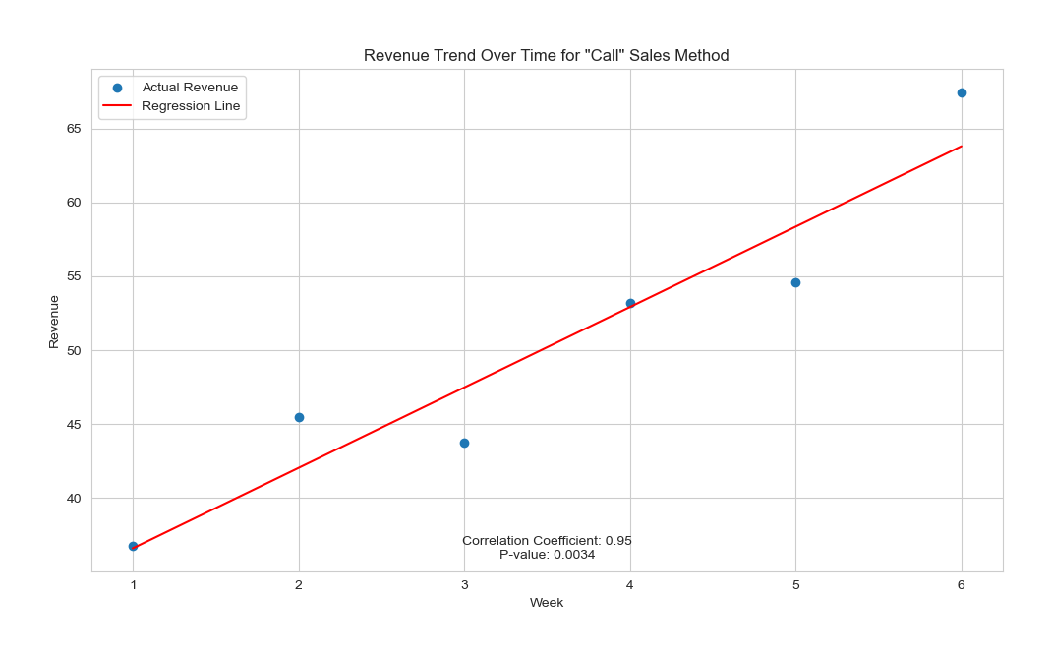
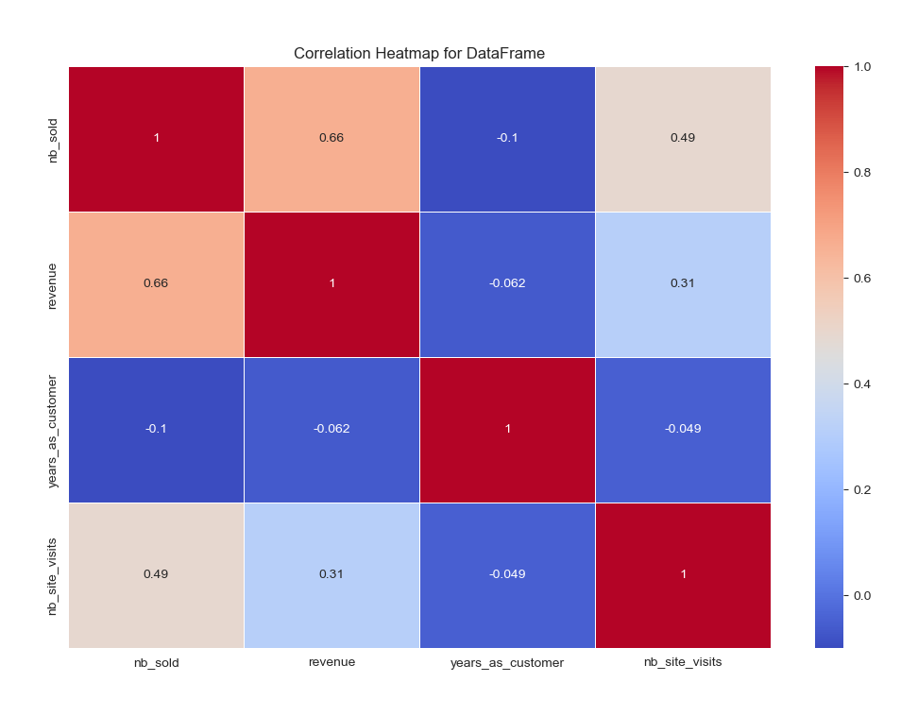
Summary of data analysis process
Univariate analysis
Bivariate analysis
Multivariate analysis

Slide 5
Key findings
1 - mixed method (Email + Call) generates the most revenue but is the least used
2 - number of site visits is positively correlated with revenue
3 – revenue generated by each sales method gradually increases from product launch

Slide 6
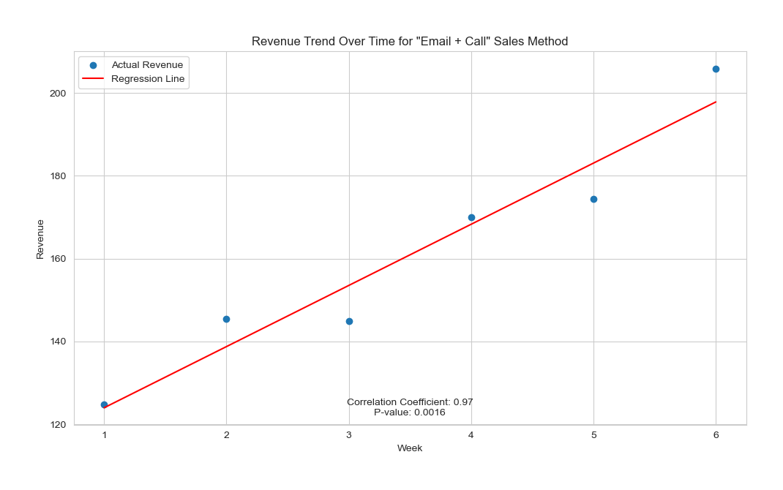
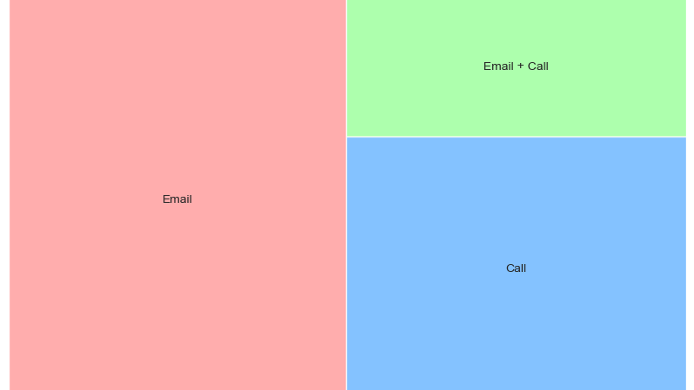
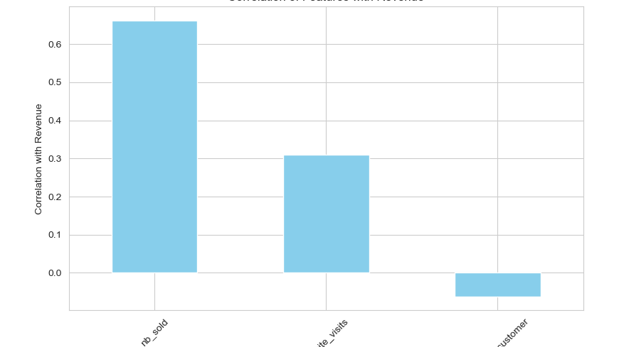
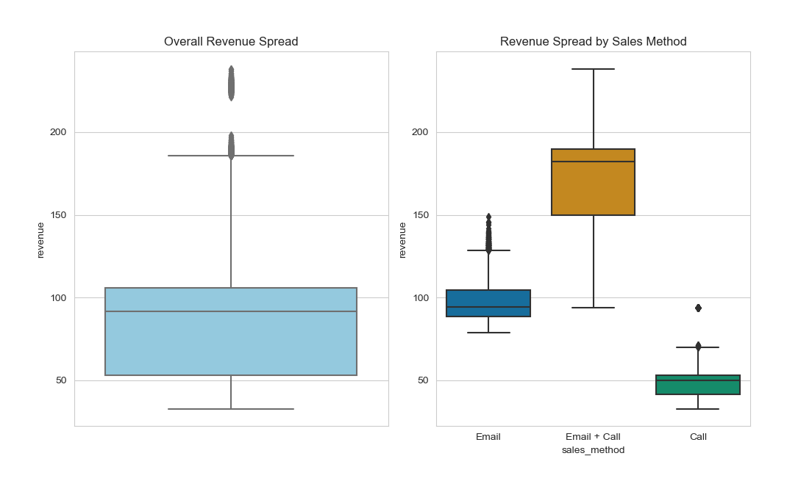
Key findings

Slide 7
Business monitoring metric (KPI)
KPI = mean(revenue)/mean(nb_site_visits)
KPI₀ = $3.76 (one site visit generates $3.76 revenue)
This helps to monitor:
Business revenue growth
Customer adaptability to technological advancements
Customer engagement

Slide 8

recommendations
Prioritize the mixed method (Email + Call), but by optimizing the Emails and reducing calls
Set up a clear weekly strategy/plan to closely monitor and correct the metric (KPI)

